Slide 1
Mind-Reading Earphone
Anonymous group

Slide 2

Preface
Do you want to know what your friends are thinking about?
Do you want to know why your girlfriend gets angry again?
Do you want to know who the teacher wants to flunk?
Do you want to know which question the teacher wants to put into the test?
The mind-reading earphone can help you!

Slide 3
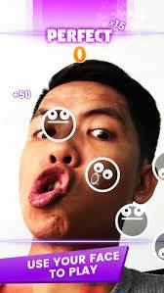
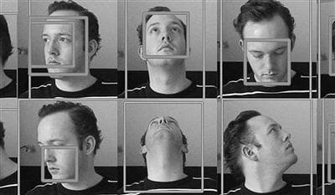
Now
Normal way:
              Facial expression
Psychological way:
Micro emotions
Notes:
Nowadays, if we want to know what the others thinking
We can only use the normal way:
Observe others facial expression and guess what they are thinking
Or we can also use the psychological way:
Micro emotions

Slide 4
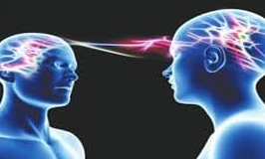
Future
We have more convenient, precise, and unique way:
Brain wave reading!!!

Slide 5
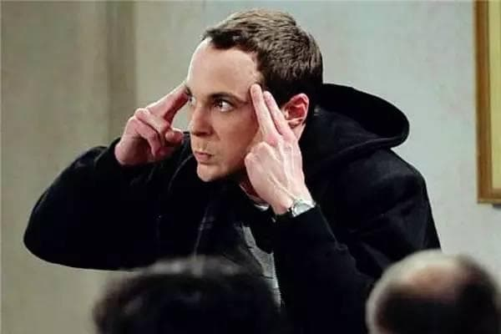
Principle
Brain wave reading:
    the essence of the brain wave is an electrical signal.The brain wave technology is to collect signals when people are thinking and translates them into the signals that the machine can identify.
Notes:
According to the research, the essence of the brain wave is an electrical signal. Each of human activities generates different electrical signal. The brain wave technology is to collect these signals when people are thinking, then finds the regularity by the big data technology and translates them into the signals that the machine can identify.

Slide 6
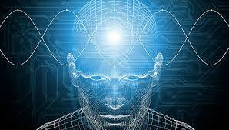
原理
腦電波讀心:據資料顯示，腦波的本質是一種電信號，人類的各種活動都會產生能量不同的電信號.腦波科技就是採集人類思考時產生的電信號，利用大數據技術找出規律性，從而進一步翻譯成機器可識別的信號。

Slide 7
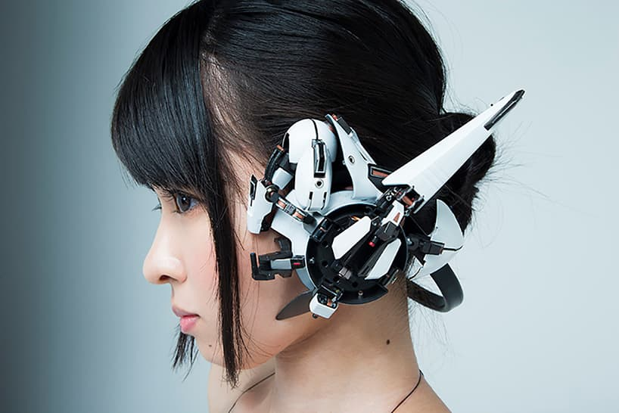
  And !
We put this incredible technology into a small earphone!

Slide 8
Usage

Slide 9

Deception Detection
Detect the deceptions.
The police can find out the truth faster.
It can find out the truth that he or she has an extramarital affair or being betrayed by friends.

Slide 10

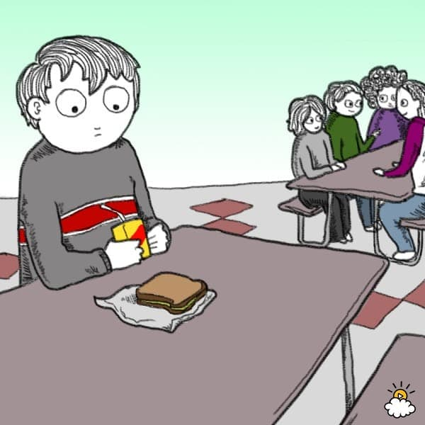
Autism
Talking with autistic patients and opening their isolated minds.

Slide 11
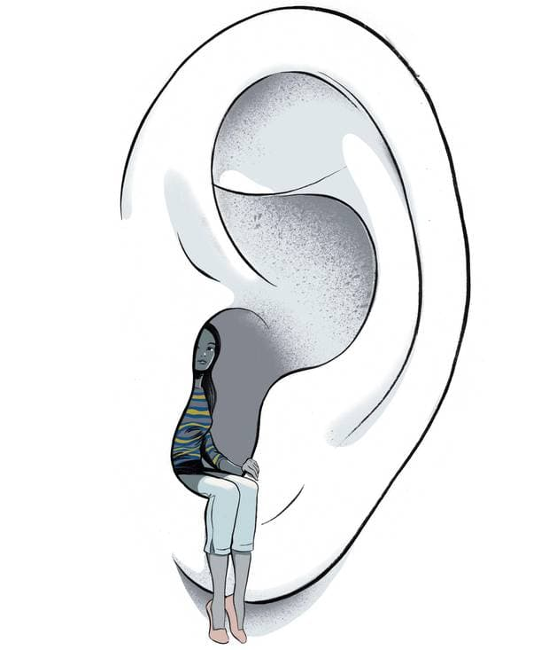

Deaf people
Can also use the mind-reading earphone to communicate with them, so they can expand their social circles.

Slide 12

Spy
Speaking will no longer be the only way to carry out the missions, which will make the spies accomplish the goal more easily.

Slide 13

Artificial limb
The disabled people control the movement of the artificial limbs with their minds.

Slide 14

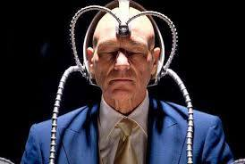
Ethics
Someone may invade others privacy.
We may get the truth that may hurt us.
Without the processes of the communications, it will be more and more unfamiliar between people.

